Slide 1

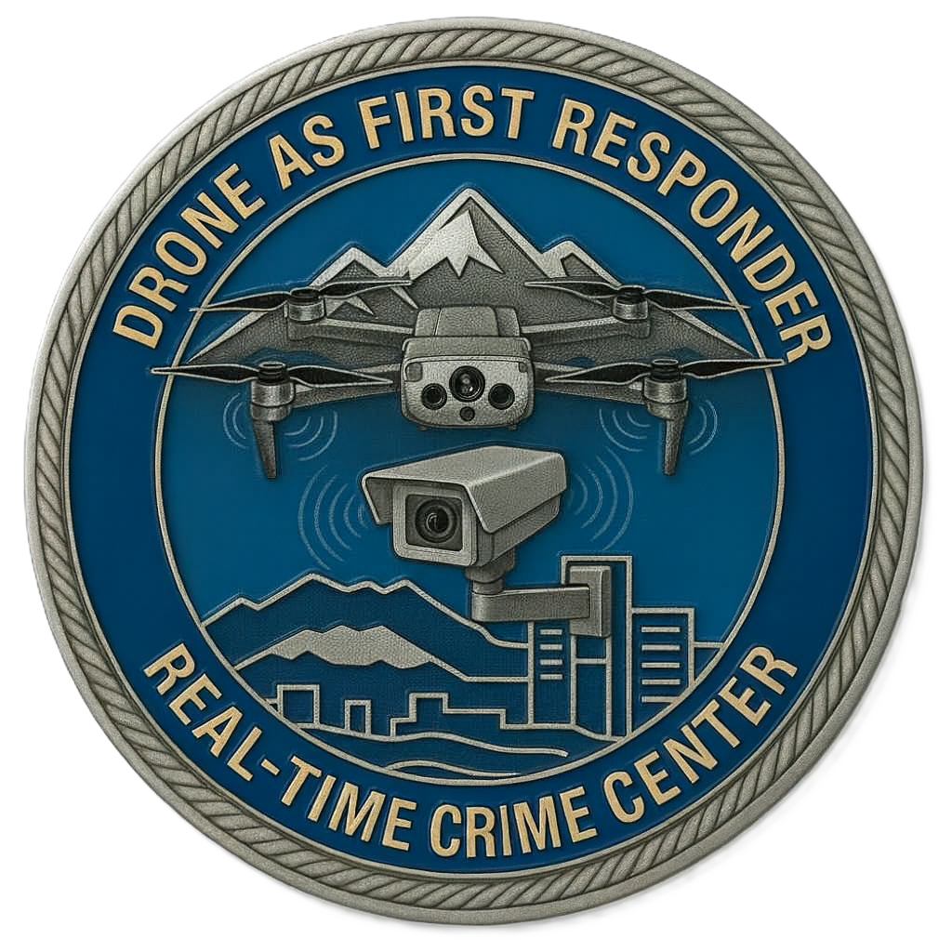


Slide 2
ARGUS:
Established in 2014
Supervised by the Investigations Commander.
1 full-time employee.
Proactive monitoring of the radio and cameras. Also responsible for fulfilling requests for evidentiary video capture.
By 2023, Argus was only staffed by 2 variable-time employees.
No proactive monitoring of the radio or cameras. Argus was only fulfilling requests for evidentiary video capture.
In 2024, Argus was moved from investigations to support services under the DRVR (Digital Records Video Release) Sergeant.

Slide 3
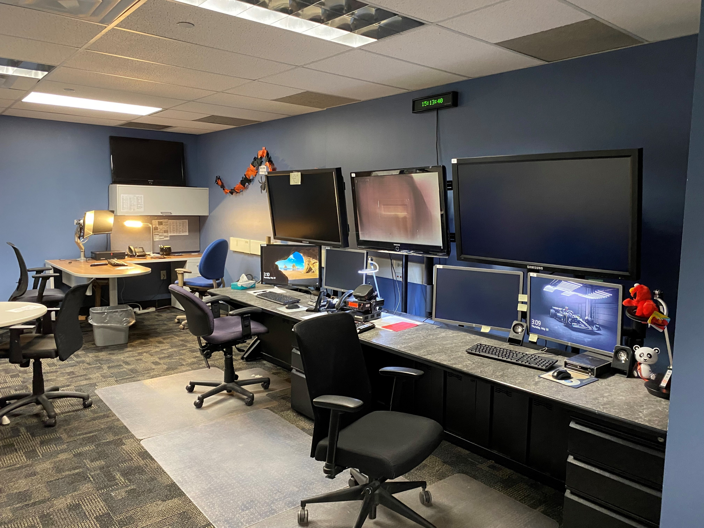
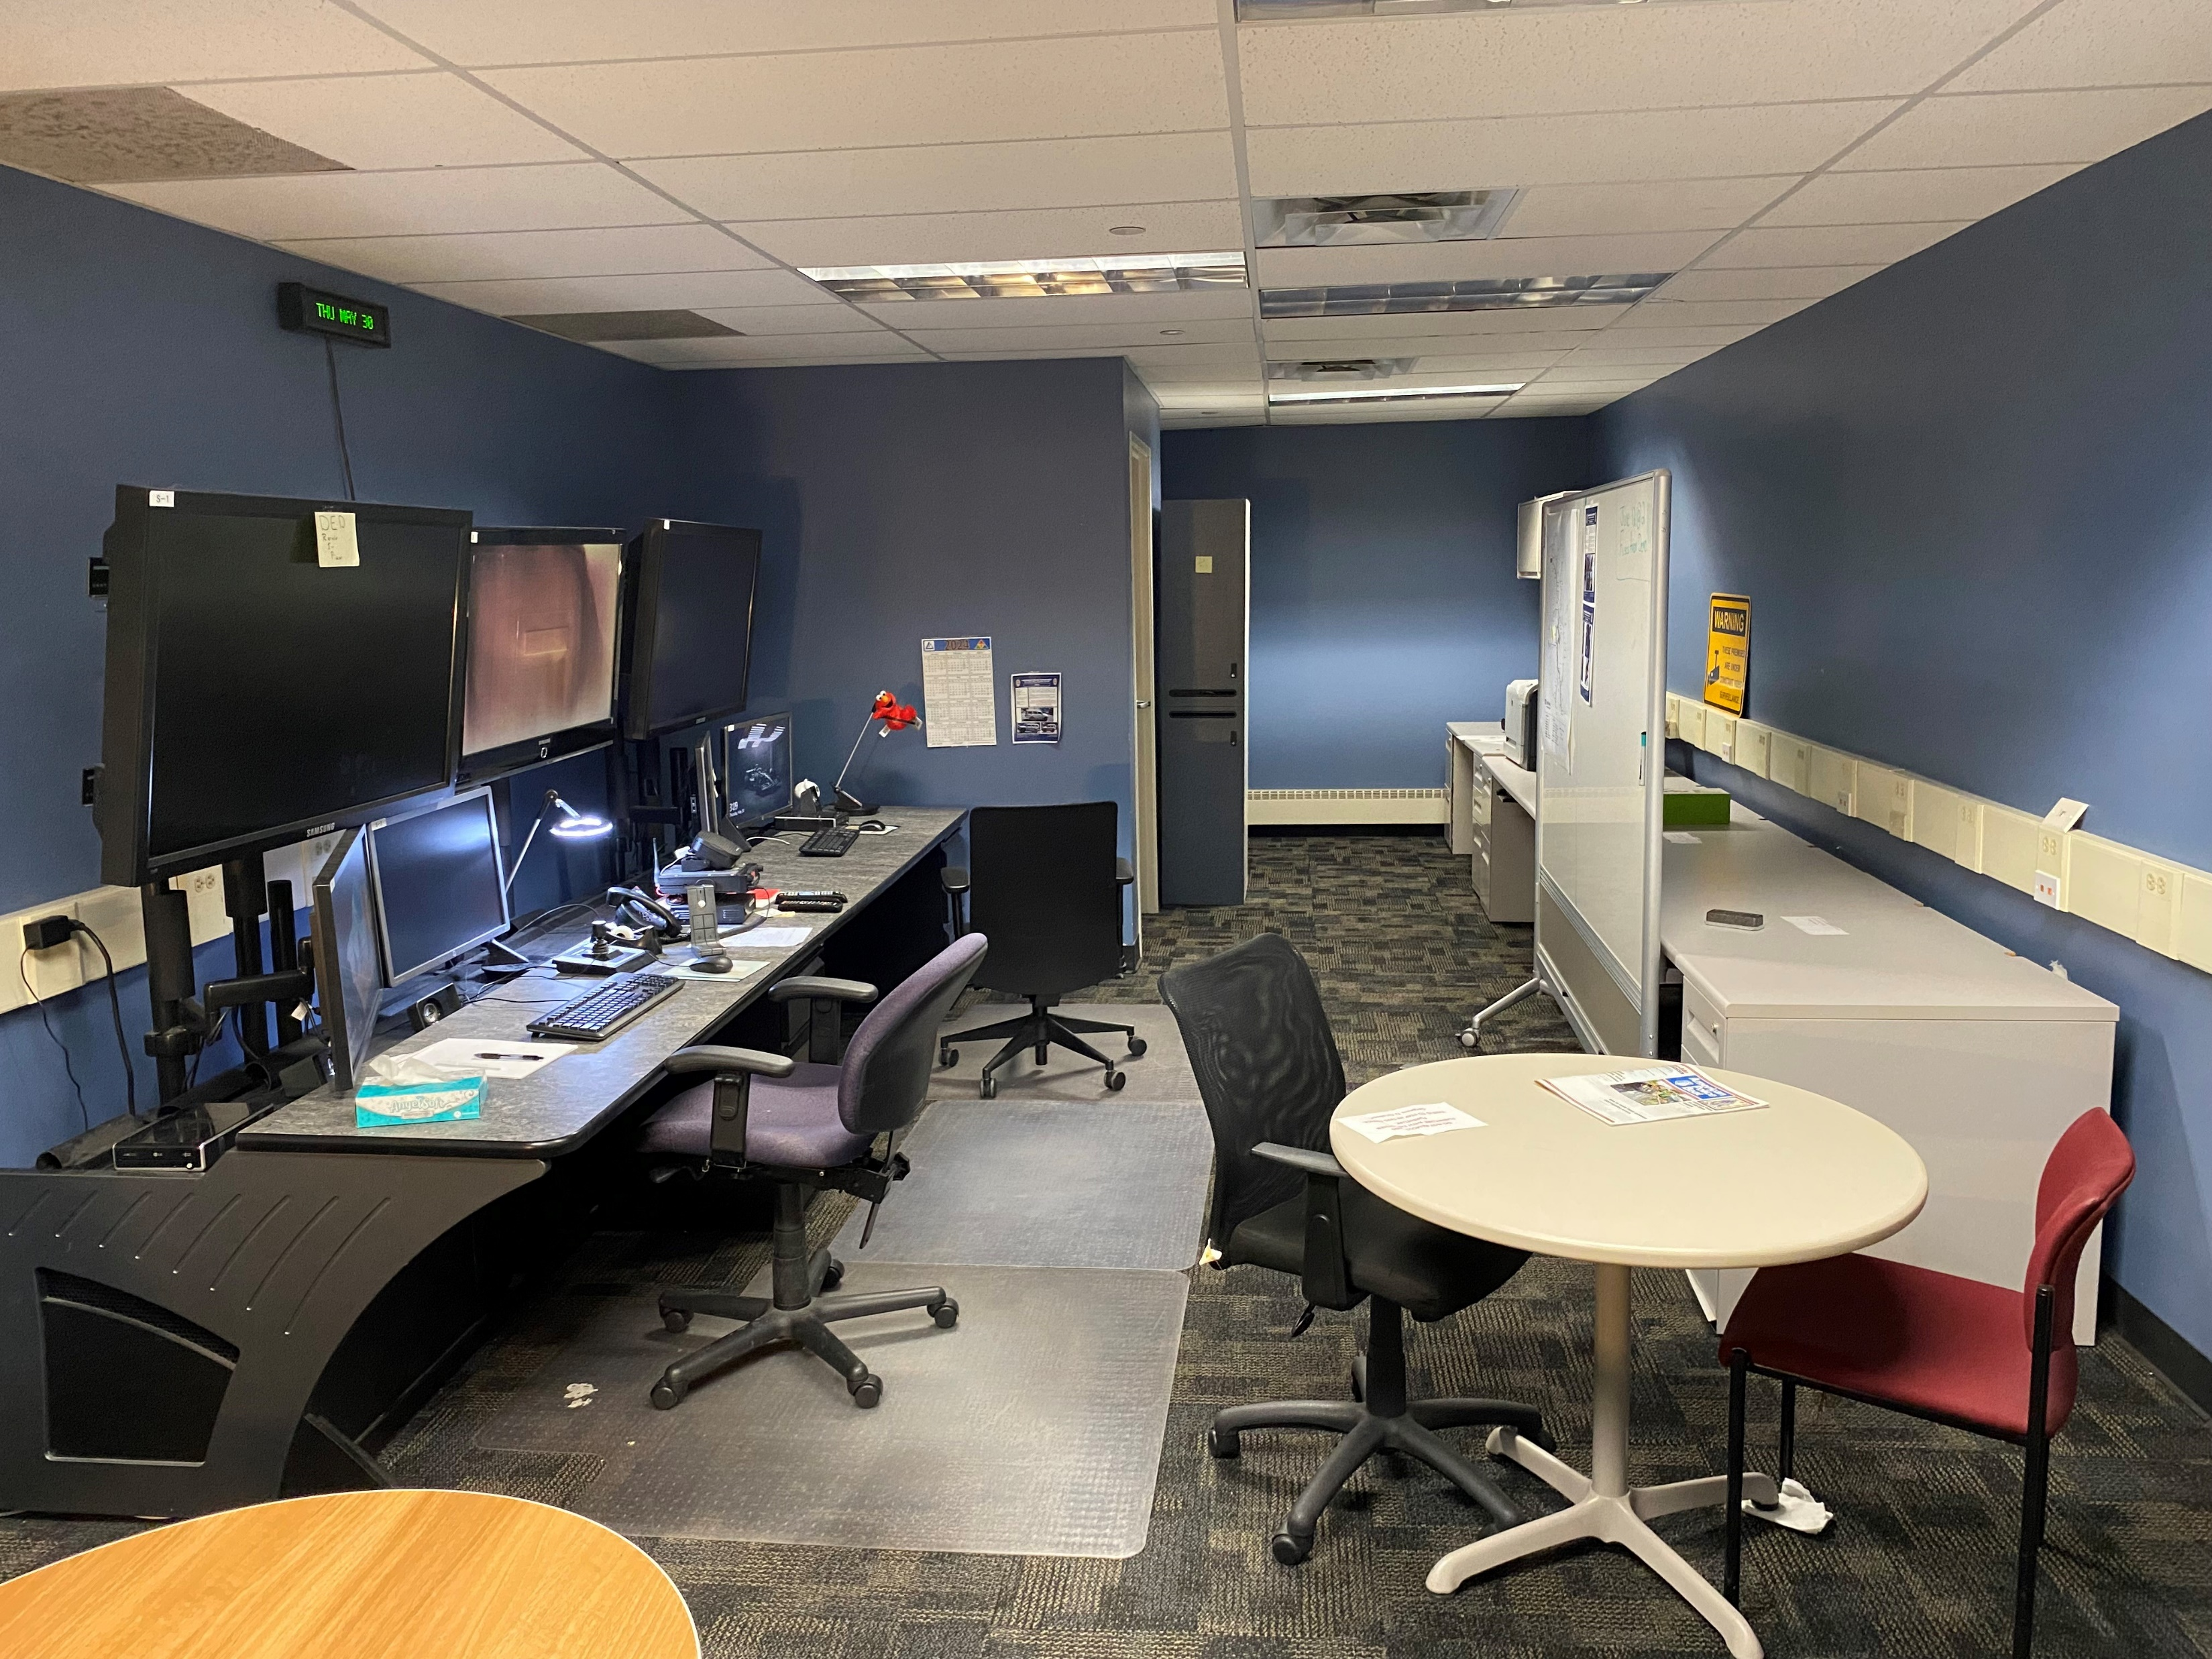
Never forget where you came from…….
ARGUS COMMAND CENTER

Slide 4

Real-Time Crime Center:
2023 Chief Philip Smith becomes the Lakewood Police Department’s new Chief of Police. He announces his vision for the future of the department which includes the implementation of a Real-Time Crime Center.
Late 2023/early 2024 the support services division is tasked with the creation of a Real-Time Crime Center.
2024 the Argus unit begins transitioning to a RTCC operational model.
June 2024 the Argus Command Center receives a complete technology overhaul and is rebranded the Real-Time Crime Center.
April 2025 Drone as First Responder begins operations from the RTCC.
June 2025 first full-time RTCC Technician and DFR Pilot is hired.
July 2025 the DRVR Sergeant position is transitioned to the RTCC/Technology Sergeant.

Slide 5
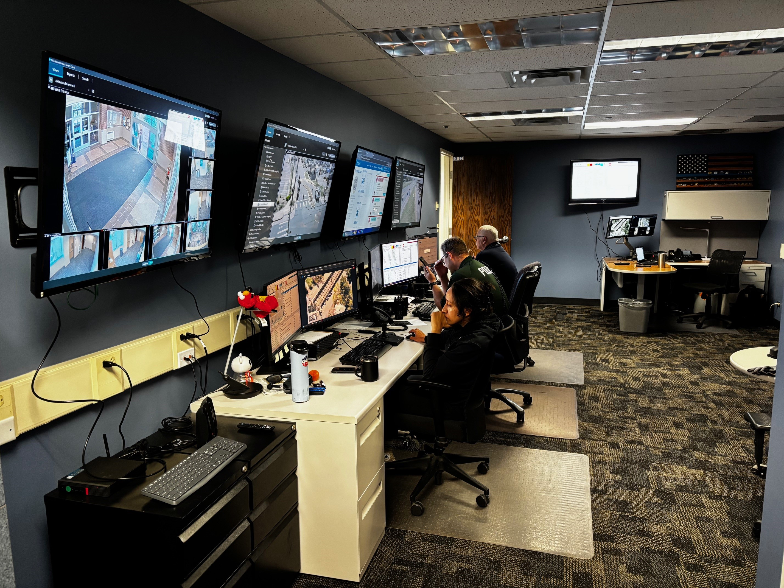
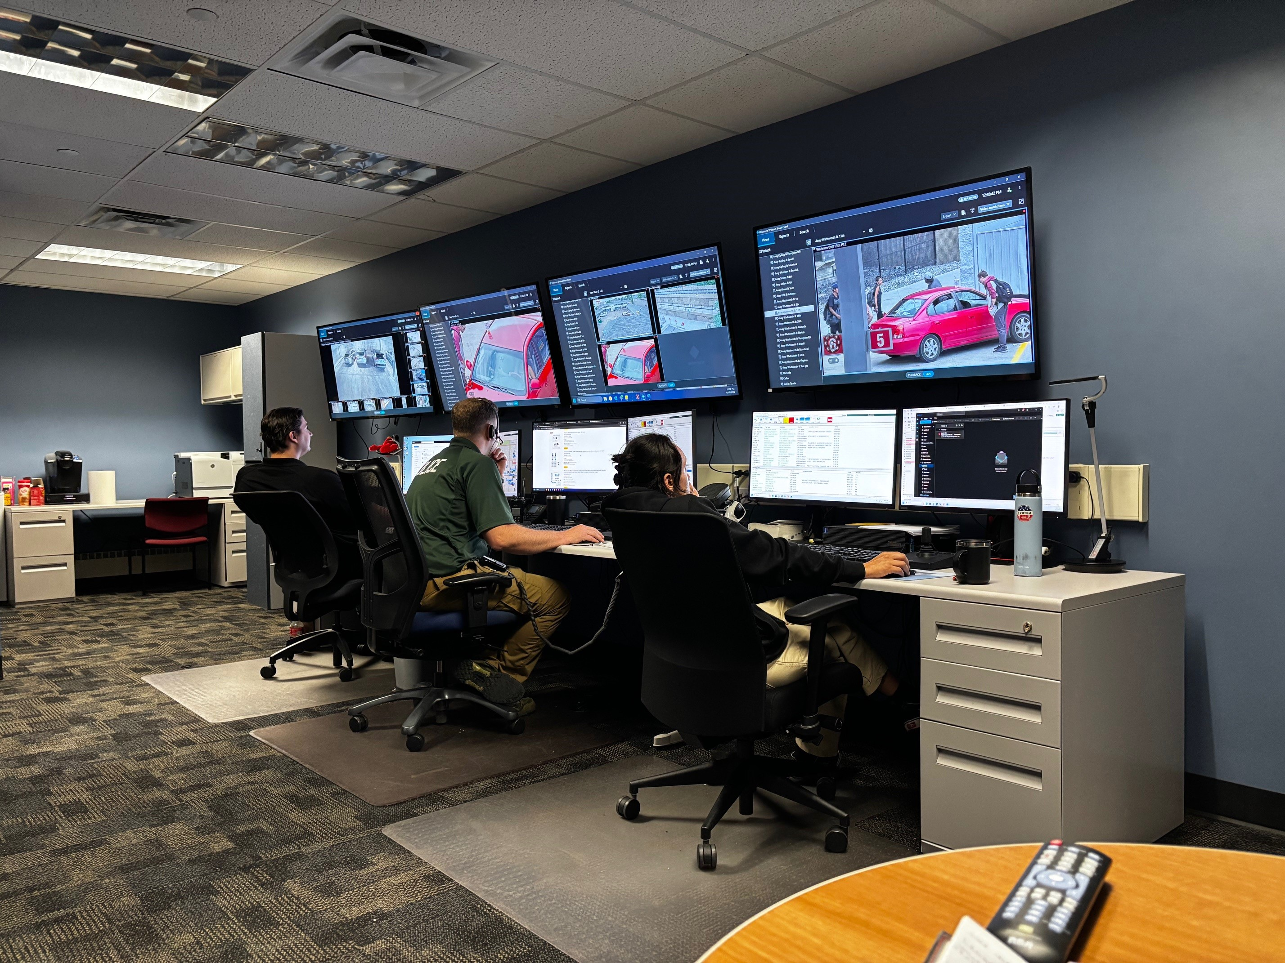
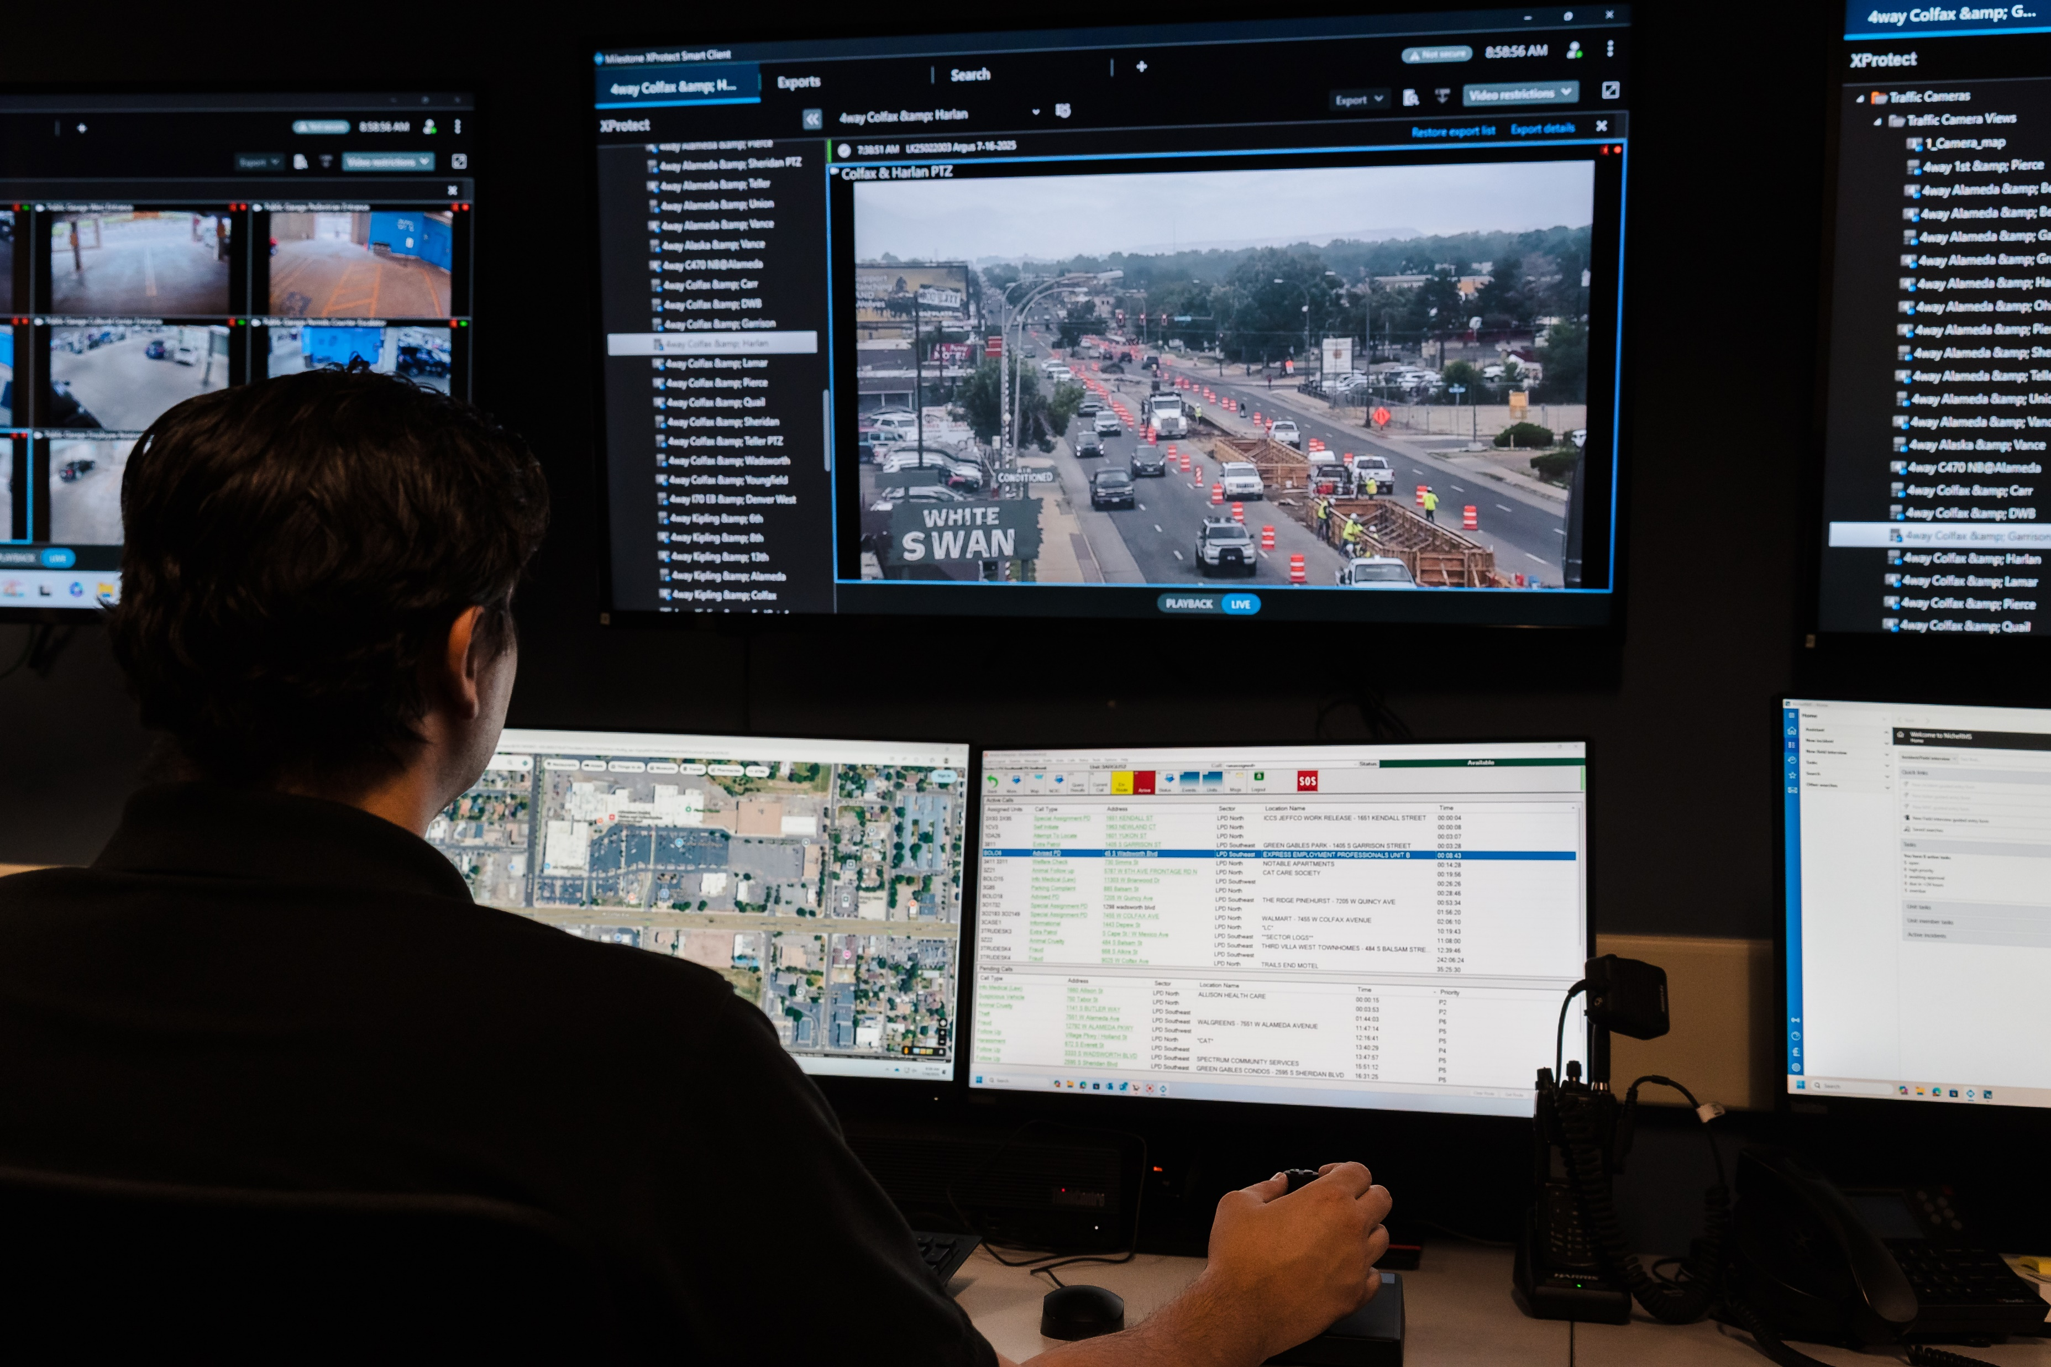

Slide 6
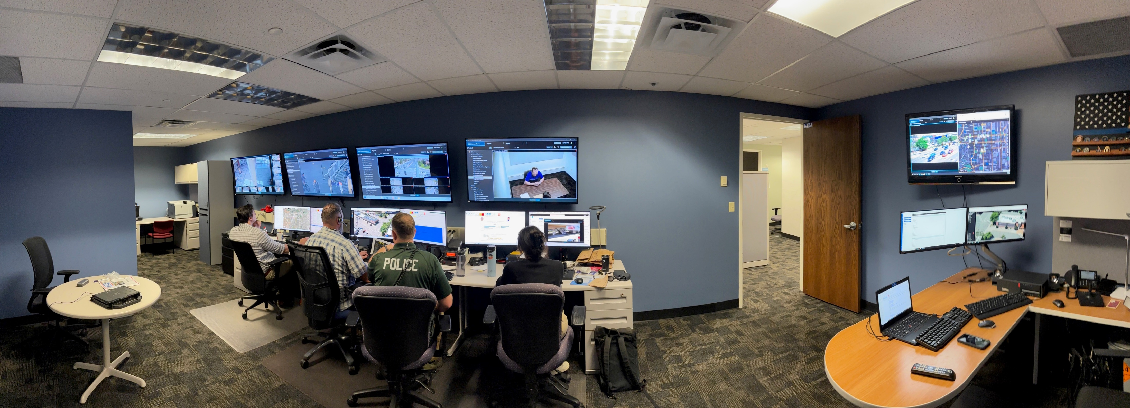

Slide 7
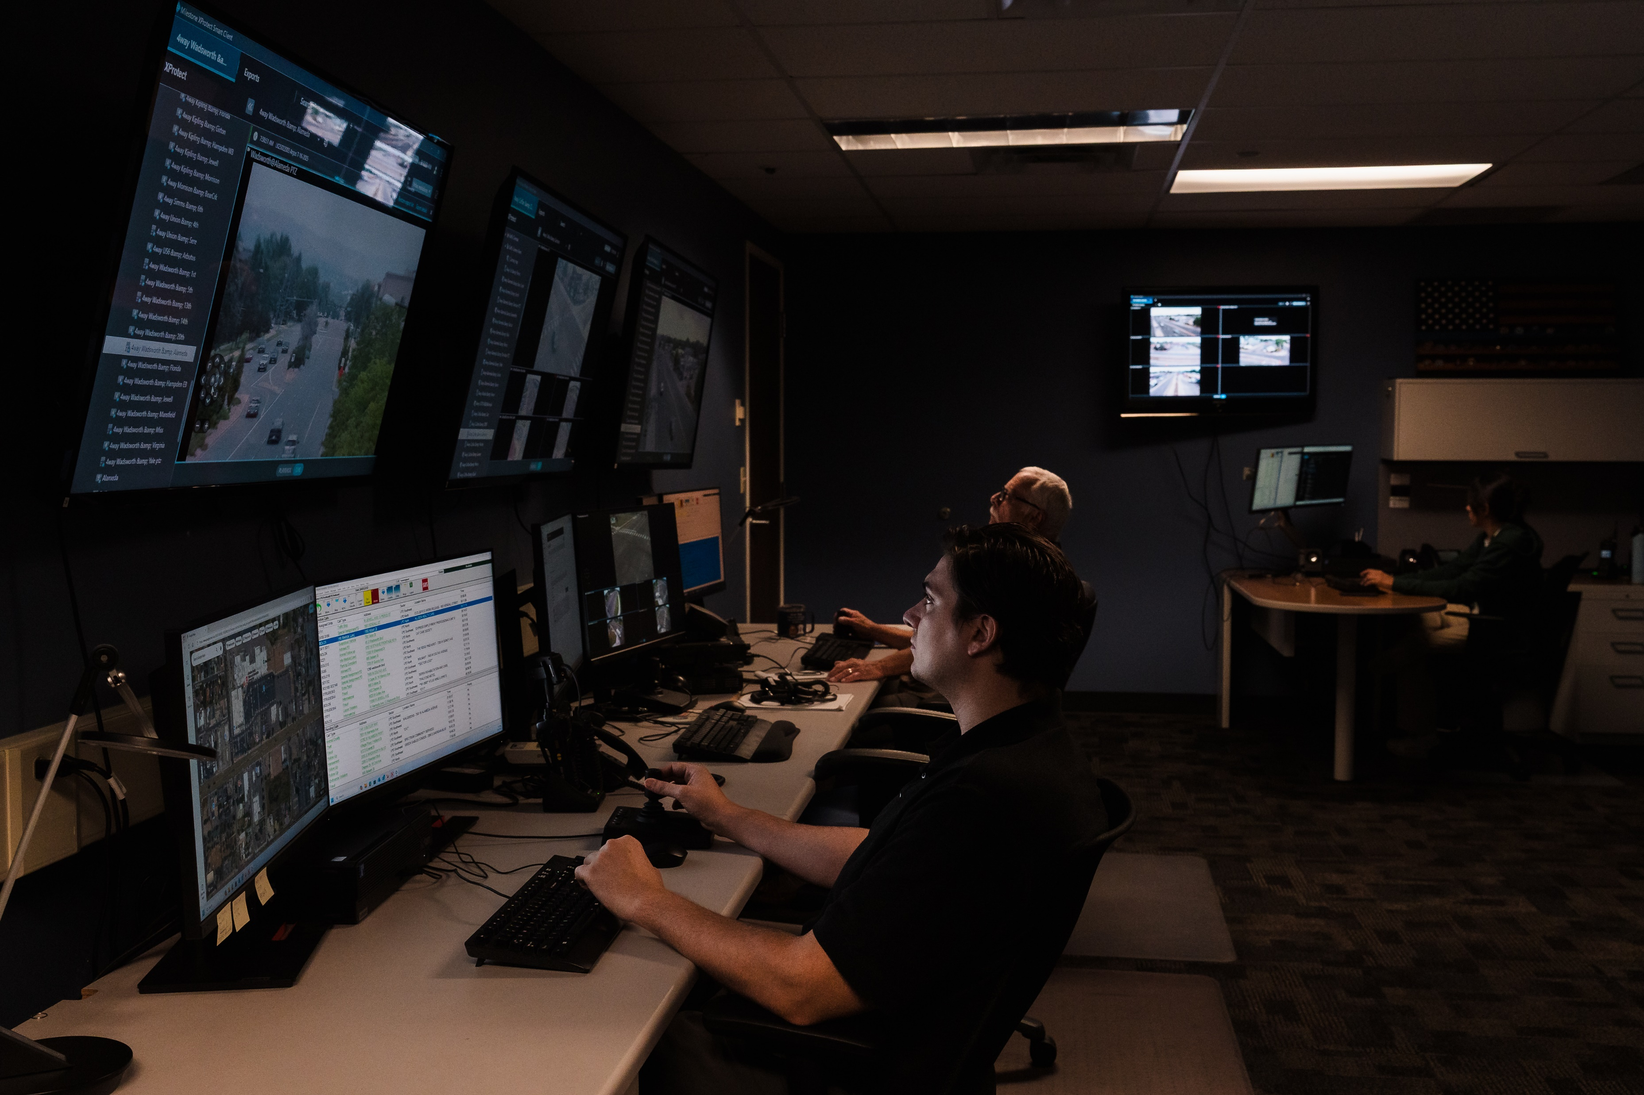
Technology:
DFR: 2 Skydio X10 Docked Drones*
634 video streams (Milestone)
32 ALPR Cameras
Fusus (500 internal video streams 100 of which are AI empowered)
Community Connect
*A 3rd Skydio X10 docked drone in partnership with the Mills Mall Metro District (They have also committed to providing access to their CCTV system via a Fusus Core)

Slide 8
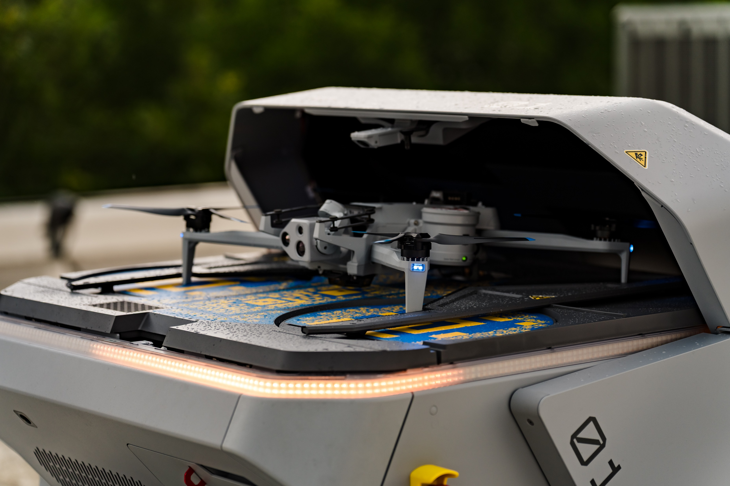
Drone as First Responder
DFR is remotely piloting, agency-owned drones in response to calls for services or Agent initiated activity to provide real-time aerial intelligence. The drone often arrives before patrol units enhancing situational awareness, improving decision-making, which increases officer and public safety.
LPD was the first agency in Colorado to obtain a waiver for remote drone operations without a visual observer from the FAA.
Started with crew-based operations and grew the program to 2 docked drones.
A 3rd docked drone out at the Colorado Mills Mall will be operational in a few weeks.

Slide 9
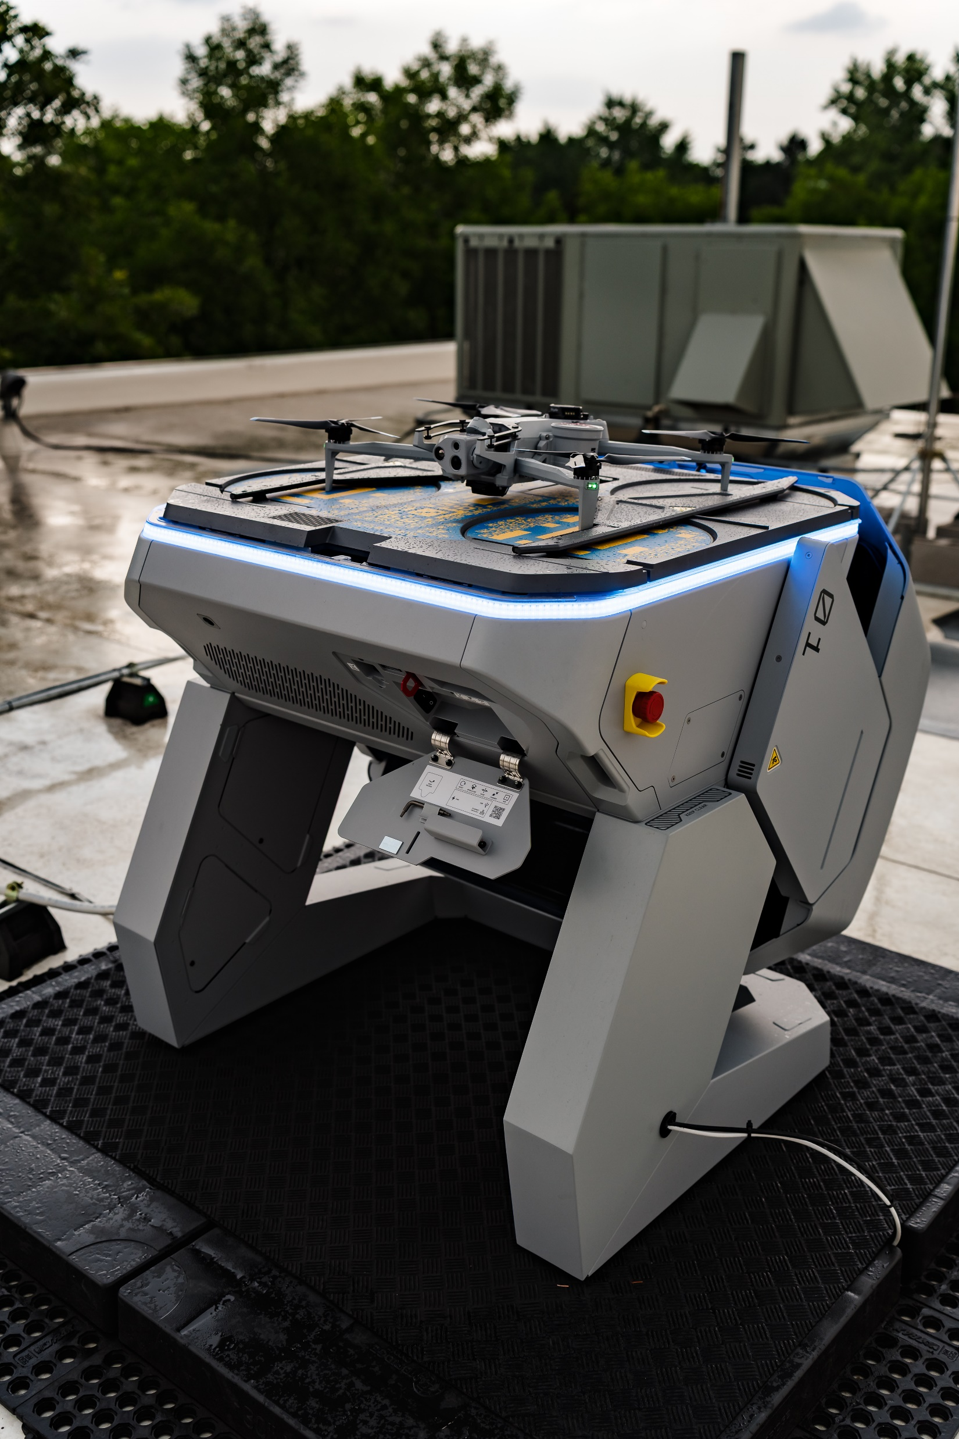

We operate Skydio Docked X10s
Docks:
Self-contained launching and landing platforms for the X10.
Thermal controlled
Contact charging
X10:
All purpose drone.
Capable of operating in temperatures from -4 to 113 degrees F, winds up to 28mph and moderate rain.
Can fly at 36 MPH with and operational range of 2 miles.
Flight time at altitude is ~30 minutes. This can vary with weather conditions.
Equipped with 120X zoom camera, thermal imaging, Night Sense obstacle avoidance and a parachute.

Slide 10
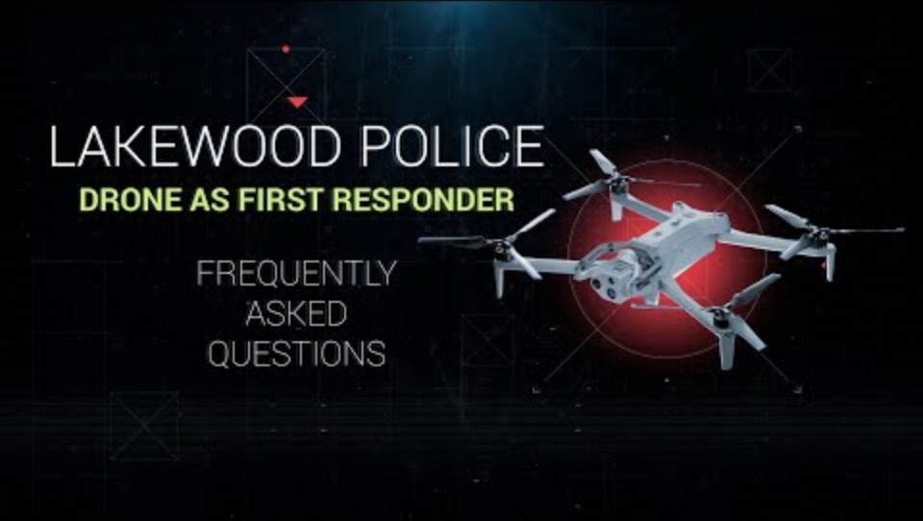

Slide 11
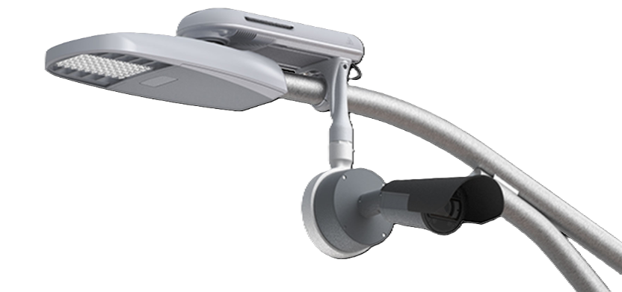
Automated License Plate Readers (ALPRs)
ALPRs are a camera-based technology that captures license plate images and converts them into searchable data (plate number, date, time, location).
Primary Uses:
Locating stolen vehicles
Identifying wanted or missing persons
Supporting investigations
Enhancing real-time situational awareness
Operational Value:
Increases efficiency by automating vehicle identification
Provides investigative leads that may not otherwise exist
Acts as a force multiplier without increasing staffing

Slide 12
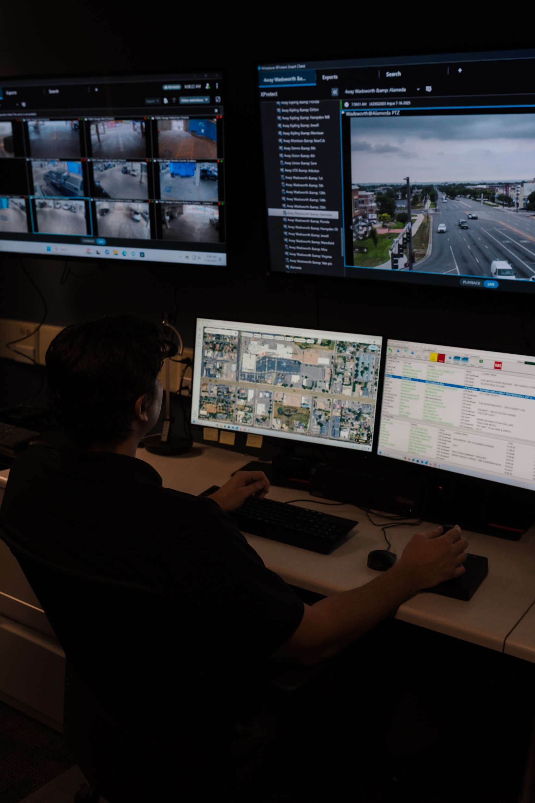
Video Streams
The City of Lakewood has around 634 available video streams. (Milestone VMS)
Primary Uses:
Enhancing real-time situational awareness
Supporting investigations
Source for video evidence
Operational Value:
Enhancing public safety
Preventing and deterring crime
Identifying criminal activity
Identifying suspects
Gathering evidence
Reducing the fear of crime

Slide 13
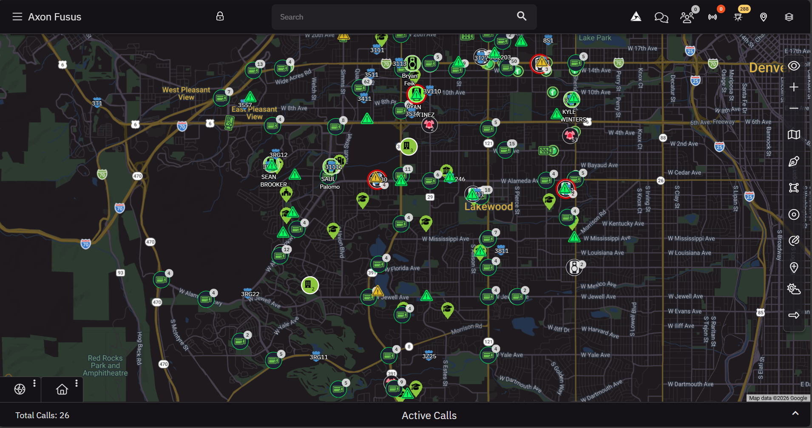
FUSUS
Fusus brings all of the RTCCs technology into one pane of glass. Officer location, alerts, dispatch data, ALPR, AVL, overlays, alerts and video feeds appear on a single live map.
Live incident managment
LPD Fusus Environment
400 standard video streams
100 AI empowered video streams
Live CAD Data
AVL
Drone Feeds
Agent BWCs
32 ALPR cameras
Strategic Floorplans
Traffic and Weather Overlays

Slide 14
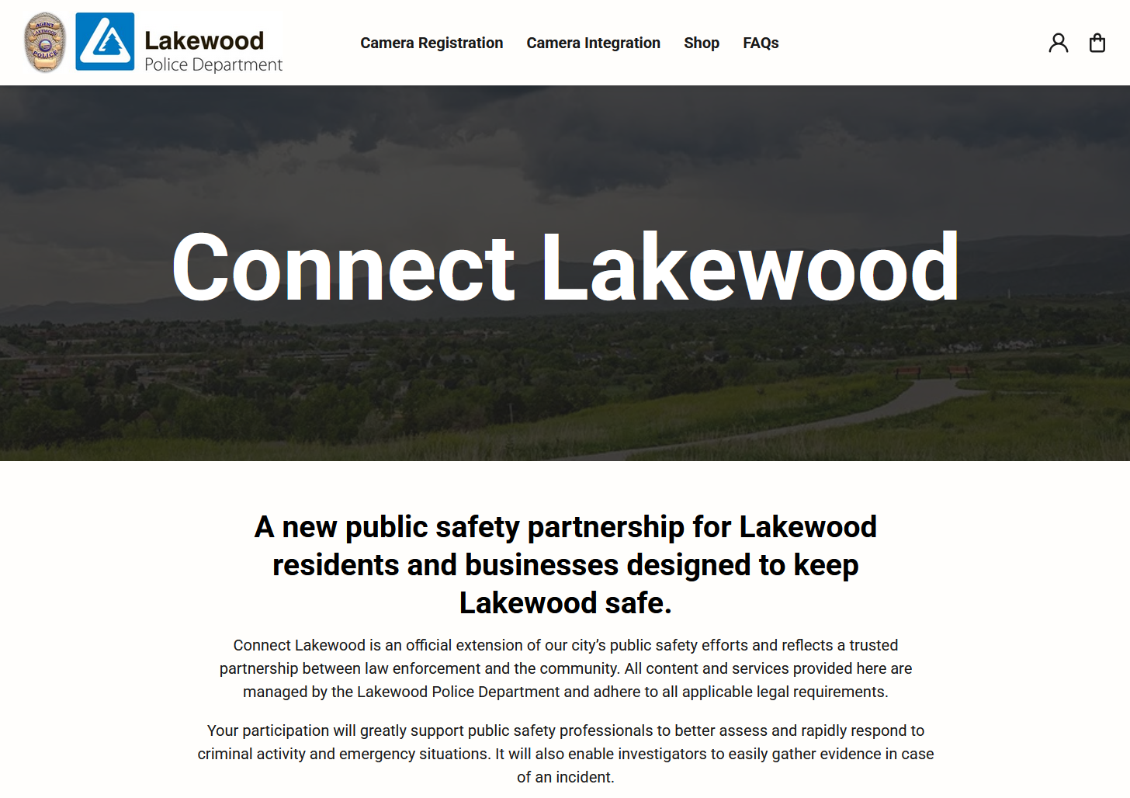
Community Connect
Camera Integration
Allows external entities to seamlessly integrate their camera systems with LPD via Fusus.
They maintain complete control over their camera systems.
They control what level of access LPD is given.
Camera Registration
Lets LPD know you have a camera and where that camera is.
LPD can reach out to camera owners via the registry if they believe the camera may have video that would assist an investigation.

Slide 15
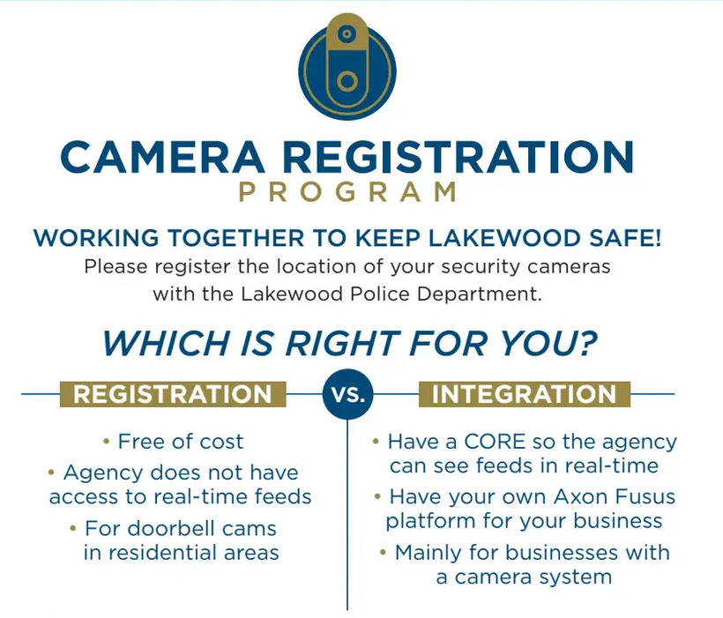

Slide 16


Slide 17
Staffing:
Sergeant
2 Full-time RTCC Technicians (1 hired, 1 open hiring process)
2 Variable-time RTCC Technicians (60 hours available)
Creative Staffing:
Tactical drone pilots (sworn) are reassigned to the RTCC for their shift when patrol deployment allows.
Community Service Officers (non-sworn) are currently receiving training to be able to serve in the RTCC.
Light duty Agents.

Slide 18
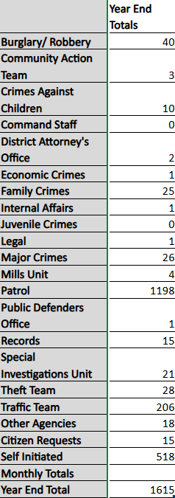
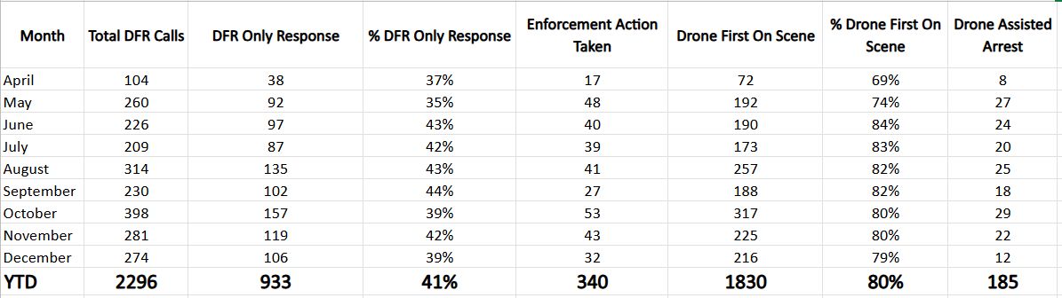
RTCC Stats
Drone as First Responder

Slide 19
Questions?

Slide 20
Funding:
The RTCC’s room technology came out of the Support Services budget and is now on the City’s IT refresh schedule.
Drone as First Responder (2 - X10 Docks) was written up as a 1-year budget exception in the 2025 budget with an opportunity to prove the concept.
In the 2026 budget year, the program received ongoing funding through the conclusion of our current Axon contract (BWC, Taser).
The Skydio DFR contract was built into an addendum to our Axon contract that also included Fusus and Draft One.
Our 3rd X10 Dock will be a private/public partnership paid for by the Colorado Mills Mall Metro District and operated by the LPD RTCC.
The current Sergeant position in the RTCC was an existing Sergeant position that was reallocated to the RTCC.
The initial FTE RTCC Technician was another reallocated position. The second FTE RTCC Technician is a new position created as part of the 2026 year’s budget process.
2 VTE RTCC Technicians were already budgeted for through the prior Argus unit.

